Slide 1

Tissue Processing
By Dr. Thaer Ali

Slide 2
Tissue processing : A procedure which need to take place after gross examination between tissue fixation and the embedding and then sectioning of paraffin blocks.

Slide 3
Steps of tissue processing in histopathology laboratory
There are main 2 steps in preparation of slide:
1. Sectioning of tissue
2.Staining of tissue
1.Sectioning of tissue are 2 Types
A. Frozen sectioning
B. Paraffin sectioning
2.Staining of tissue are 2 types
A.Routine stain: H and E stain
B.Special stain: PAS stain,Giemsa stain.

Slide 4
Paraffin sectioning can be done 2 ways:
1.Automated tissue processioning
2.Manual t. p.
Tissues that come to the histopathology laboratory are
a. Biopsy specimen like cervical biopsy.
b. Resected disease organ like gall bladder, uterus, breast , soft tissue etc.
c. Resected organ or tissue after chemotherapy or radiotherapy.
e. Autopsy

Slide 5
Protocols followed in Histotechniques
1. Receipt & Identification
2. Labeling of the specimen with numbering
3. Fixation
4. Dehydration
5. Clearing
6. Impregnation
7. Embedding
8. Section cutting
9. Staining
10. Mounting

Slide 6
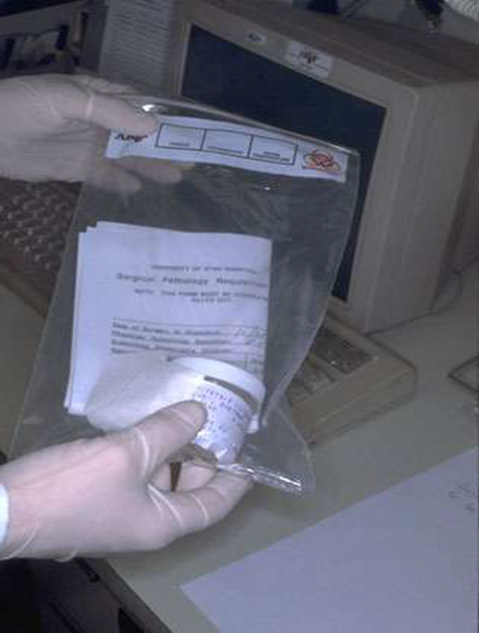
Specimen identification & labeling

Slide 7
Fixation
It is a process in which a specimen is treated by exposing it to a fixative for a particular period of time in order to facilitate the succeeding steps.
The purpose of fixation is to preserve tissues permanently in as life-like a state as possible.
The fixative should be 15 – 20 times more in volume then the specimen.

Slide 8
Aims of Fixation :
1. It prevent autolysis & putrefaction of the cell.
2. It penetrate evenly and rapidly.
3. It harden the tissues
4. Increase the optical density
5. not cause shrinkage or swelling of the cells
6. not react with the receptor sites & thus must not interfere with the staining procedure.

Slide 9
Fixation (Formalin)
MECHANISM OF ACTION:
It forms cross links between amino acids of proteins thereby
making them insoluble.
It fixes 4 mm thick tissue in 8 hours .

Slide 10
Decalcification:
It is the process of removal of the calcium salts from the
specimen.
The various agents used for decalcifying are;
• Nitric acid
• Hydrochloric acid
• Formic acid
• Picric acid
• Acetic acid
• Citric acid

Slide 11
Dehydration:
It is the process in which the water content in the tissue to be processed is completely reduced by passing the tissue
through increasing concentrations of dehydrating agents.
The various dehydrating agents used are ;
Ethyl alcohol
Acetone
Isopropyl alcohol

Slide 12
The duration of the procedure can be noted down as;
1. 70 % alcohol – 1 hour
2. 70 % alcohol – 1 hour
3. 95 % alcohol – 1 hour
4. 95 % alcohol – 1 hour
5. Absolute alcohol – 1 hour
6. Absolute alcohol – 1 hour
7. Absolute alcohol – 1 hour

Slide 13
CLEARING ( DEALCOHOLIZATION):
It is the procedure where in the alcohol in the tissue is replaced by a fluid which will dissolve the wax used for impregnating the tissues .
The various clearing agents used are ;
Cedar wood oil : The best agent but is expensive.
Benzene : It is carcinogenic.
Xylene : It is most commonly used.
Chloroform: Toxic and expensive.

Slide 14
Impregnation:
In this the tissue is kept in a wax bath containing molten
paraffin wax for 6 – 8 hours .
The wax is infiltrated in the interties of the tissue which increases the optical differentiation & hardens the tissue & helps in easy sectioning of the tissue.

Slide 15
Embedding :
It is done by transferring the tissue which has been cleared of the alcohol to a mould filled with molten wax & is allowed to cool & solidify.
After solidification, a wax block is obtained which is then
sectioned to obtain ribbons.

Slide 16
Jar containing molten paraffin wax:
Paraffin block

Slide 17
Section Cutting :
It is the procedure in which the blocks which have been prepared are cut or sectioned and thin strips of varying thickness are prepared.
The instrument by which this is done is called as a Microtome.
TYPES OF MICROTOMES:
• Sliding
• Rotary
• Rocking
• Freezing
• Base sledge

Slide 18
Parts of a Microtome ( Rotary ) :
A. Block holder
B. Knife clamp screws
C. Knife clamps
D. Block adjustment
E. Thickness gauge
F. Angle of tilt adjustment
G. Operating handle.

Slide 19
Tissue floatation bath:
It is a thermostatically controlled water bath with the inside coloure black.
It is maintained at a temperature maintained 5 – 6 degree below the melting point of paraffin
wax.

Slide 21
Staining :
Staining of the section is done to bring out the particular details in the tissue under study .
The most commonly used stain in routine practice is Haematoxylin & eosin stain.

Slide 22
Result :
The nucleus stains Blue
The cytoplasm stains pink.

